Slide 1
METODE PENCAMPURAN AGREGAT
TEKNOLOGI BAHAN DAN KONSTRUKSI
DODY WAHYU AJI SANTOSO
21010118130213

Slide 2
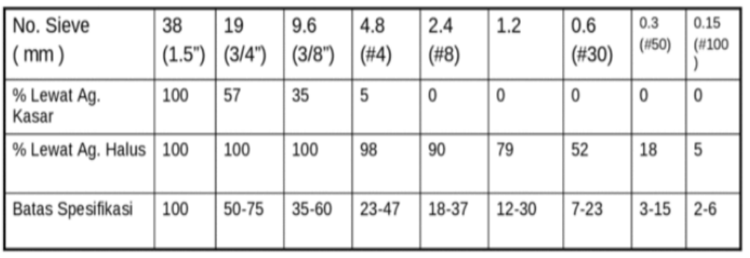

Slide 3
NO. 1
 |  |  | 1.5" |  |  |  |  | 100
 |  |  |  |  |  |  |  | 90
 |  |  |  |  |  |  |  | 80
 |  | #8
 |  |  |  |  |  | 3/4" |  | 70
 |  | 1.2
 |  |  |  |  |  |  |  | 60
 |  |  |  |  |  | 3/8"
 |  | #30 |  |  |  |  |  | 50
 |  |  |  |  |  |  |  | 40
 |  |  |  |  |  | #4
 |  |  |  |  |  |  |  | 30
 |  |  |  |  |  |  |  | 20
 |  |  | #50
 |  |  |  |  |  |  |  | 10
 |  | #100
 |  |  | Ag. Halus 67,4% |  |  | Ag. Kasar 32,6%

Slide 4
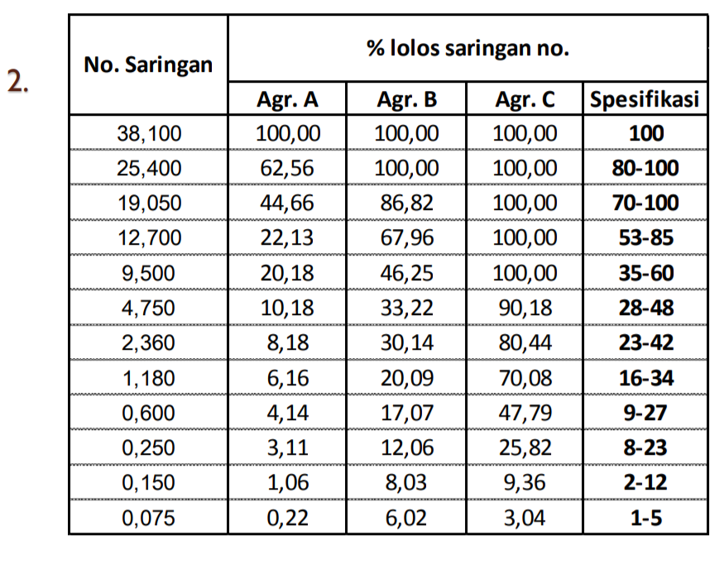

Slide 5
NO. 2
C |  |  |  |  |  | B |  | B & C |  |  |  |  |  | A
 |  |  |  |  |  |  | 100
 |  |  |  |  |  |  | 90
 |  |  |  |  |  |  | 80
 |  |  |  |  |  |  | 70
 |  |  |  |  |  |  | 60
 |  |  |  |  |  |  | 50
 |  |  |  |  |  |  | 40
 |  |  |  |  |  |  | 30
 |  |  |  |  |  |  | 20
 |  |  |  |  |  |  | 10
 |  | Ag. B 90% |  |  |  | Ag. C 10% |  |  | Ag. A 37% |  |  | Ag. B & C 63%

Slide 6
Jadi bisa didapatkan :
B = 90/100 x 63 = 56.7 %
C = 10/100 x 63 = 6.3 %

